Slide 1
Pre-Live Session 2
Frequency domain/Spectral Density

Slide 2
House Appliances energy Data Set
The data set is at 10 min for about 4.5 months. Data has 19735 rows.
The house temperature and humidity conditions were monitored and measured every 3.3 min.
Then, the data was averaged for 10 minutes periods.
The energy data was logged every 10 minutes with m-bus energy meters.
Weather from the nearest airport weather station (Chievres Airport, Belgium) was also collected.

Slide 3
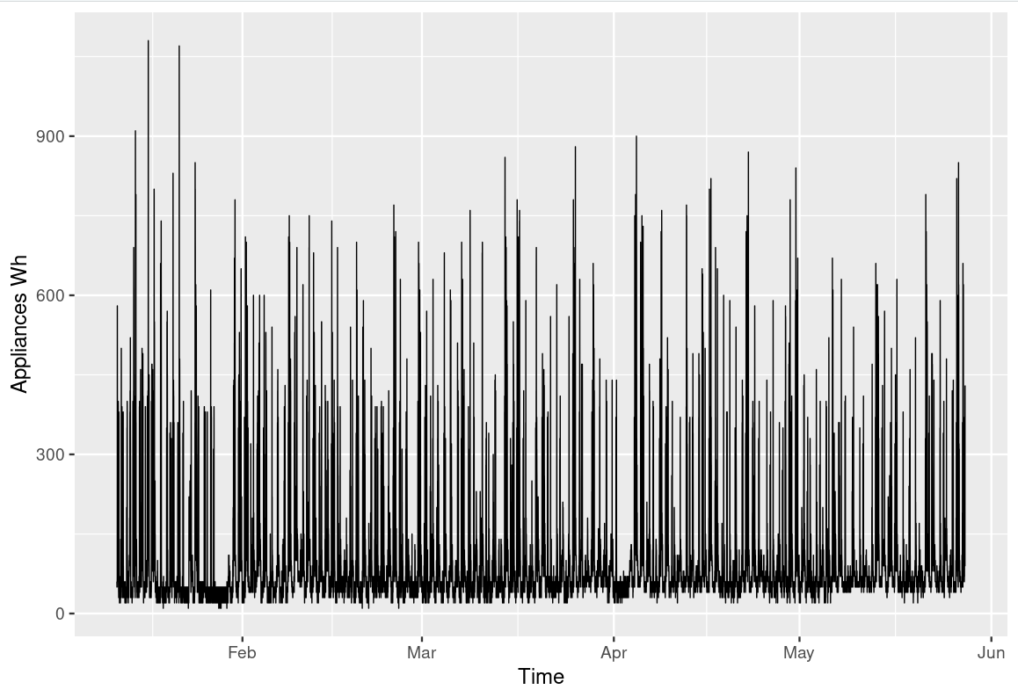
House Appliance in Wh

Slide 4
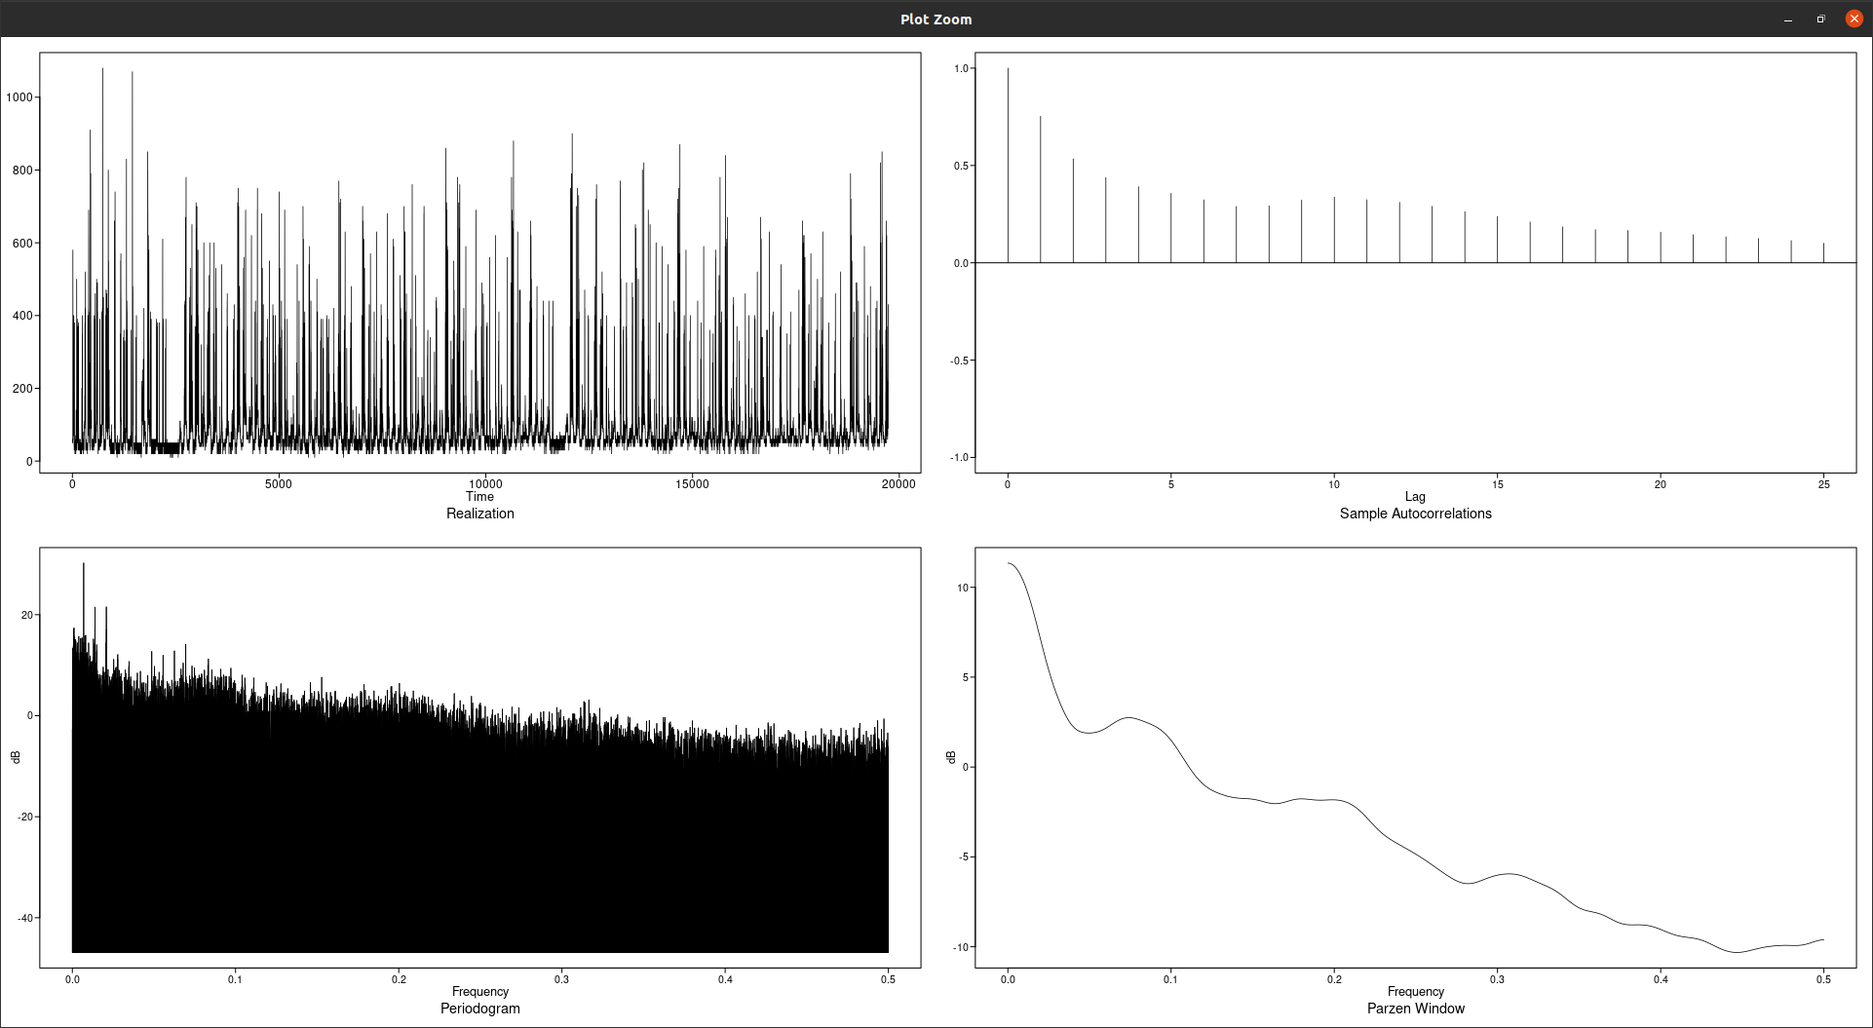
Spectral Density

Slide 5
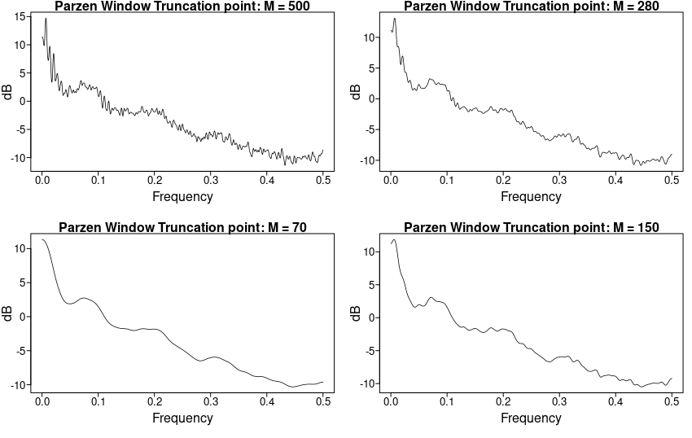
Spectral Density with different M values

Slide 6
Spectral Density Contd..
Frequencies: As you can see in the parzen window truncation, there appears to be some evidence of wandering behavior but there is also somewhat of a peak around 0.08 which could indicate a presence of frequency.
Because the data was only collected for 4 months, this could mean that there aren't any frequencies in the data or at least a very obvious one.
Based on the data, if we assume monthly frequency, then if we have 4 months then ¼ does not correspond with the peak shown in the spectral density which is at 0.08.

Slide 7
Takeaways
Different trig function(realization) with same cyclic values at a time is evidence of non-stationary time series.
Many realization are made up of various frequency component so if we can discover the frequency content of a data then we can better understand the process generating the data.
Non-cyclic type functions can be expressed as a linear combination of sines and cosines.
Fourier expansion is used for the estimation of ρ. |λ| is introduced to smooth the impact of k as k increases. So when k increases |λ| decreases. n-1 is replaced by M. M can be 2√n. M is designed to minimize the impact of autocorrelation as k goes to n. continues to work on minimizing the impact of larger autocorrelation.
Spectra estimate for a cyclic function would have a peak at the frequency of the cyclic function.
The Nyquist frequency is the highest observable frequency when sampling at the integers because you need at least 2 observations to observe one cycle.
When sampling at the integers, a series with a frequency higher than 0.5 may become aliased with series with lower frequency.

Slide 8
Questions
Does the M value also applicable when calculating ρ value before applying it to the spectral density estimate.
When we have multiple realizations in time series prediction model, do we avg the realization at each point and then build a time series model on the avg.
I remember I had the last question the last time in class and it was clear to me at the time but I can’ seem to remember what the answer was.

